Slide 1
Home Loan
We will help you in buy your Dream House

Slide 2
TEAM INFORMATION
TEAM MEMBERS:

Slide 3
PROBLEM STATEMENT
Our project is a java web-based application which provides the facility of home loan to eligible Customers. We provide a hassle-free user-friendly online platform to our users through which they can apply for loans based on their own requirements and keep a track of their status and record during the entire process of their loan approval.

Slide 4
OBJECTIVES
Our system increases user retention and simplifies loan and EMI management.
Our project is designed to be used by any individual for home loan.
Our users can view available services, policies, benefits and other information related to a specific loan. The system collects the required information about the individual and then verifies if they satisfy the eligibility criteria based on which the loan gets approved or rejected.

Slide 5
TECHNOLOGIES USED
FRONT END – ANGULAR 8
BACK END – SPRING BOOT
DATABASE- ORACLE
API TESTING TOOL USED- POSTMAN

Slide 6
Scrum Board

Slide 7
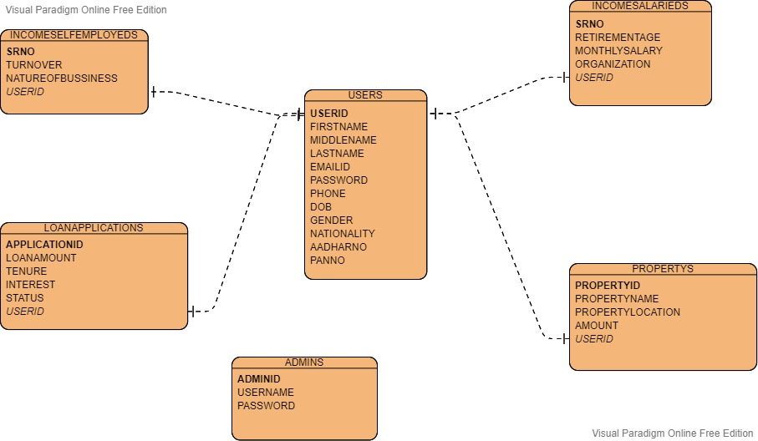
ERD Diagram

Slide 8
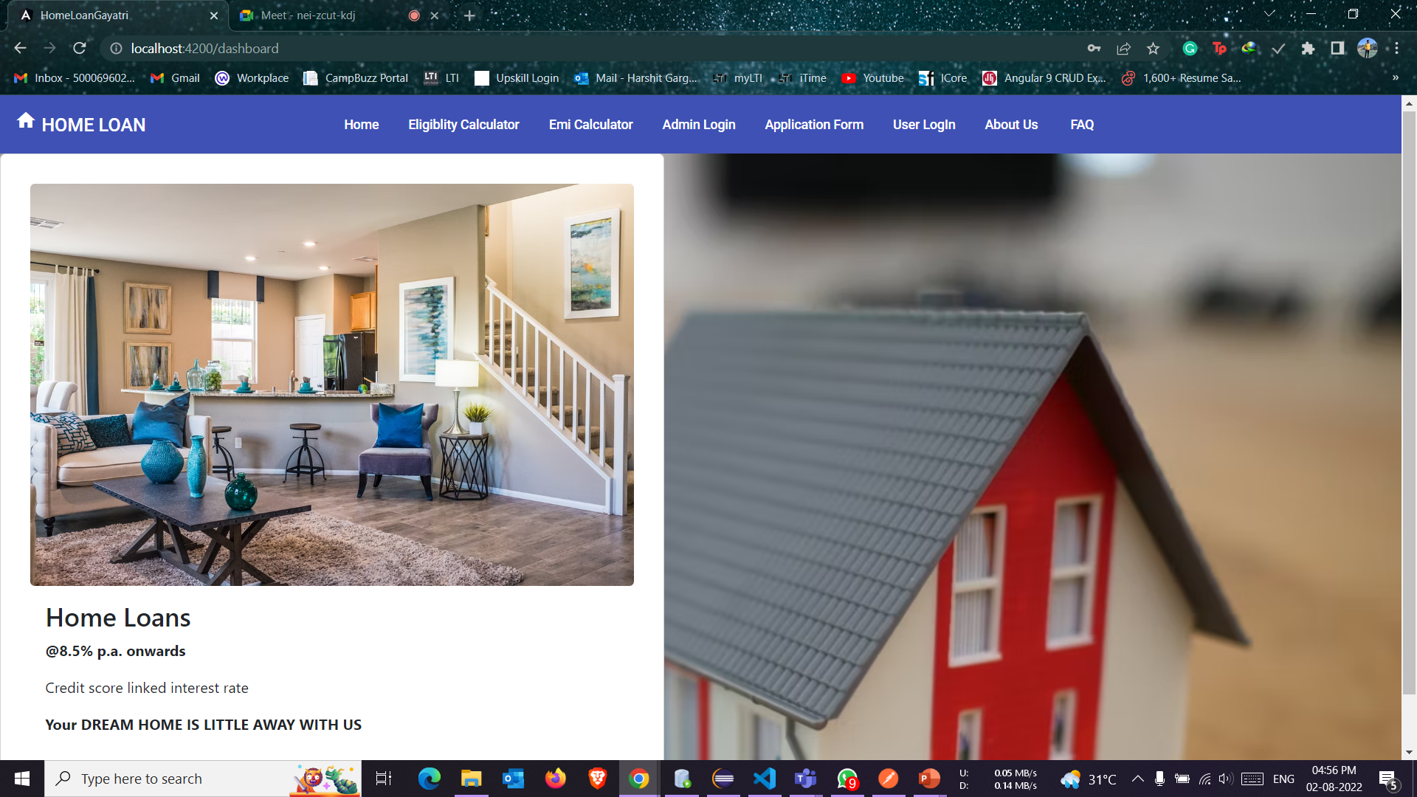
GLIMPSE OF THE PROJECT

Slide 9
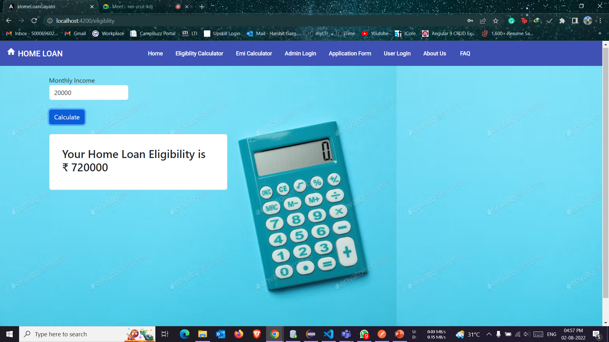

Slide 10
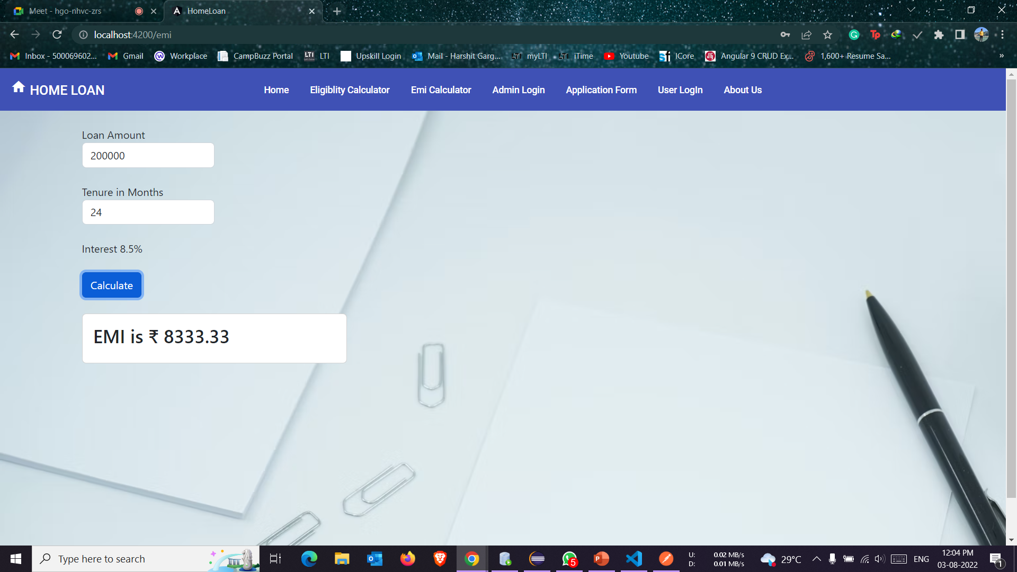

Slide 11
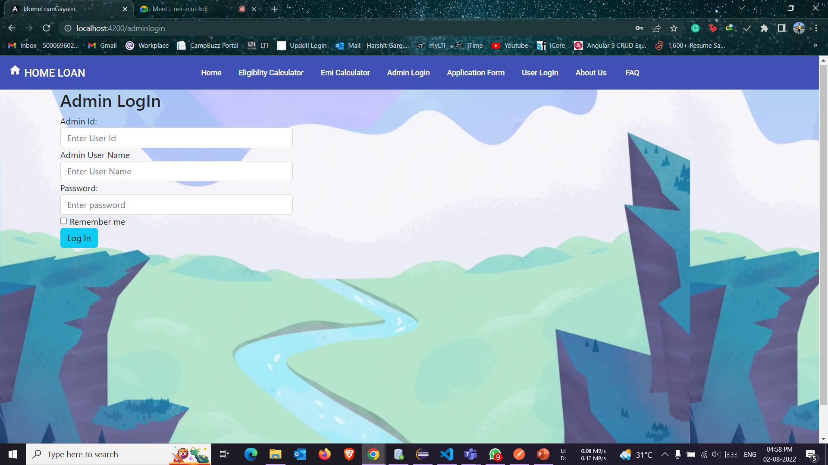

Slide 12
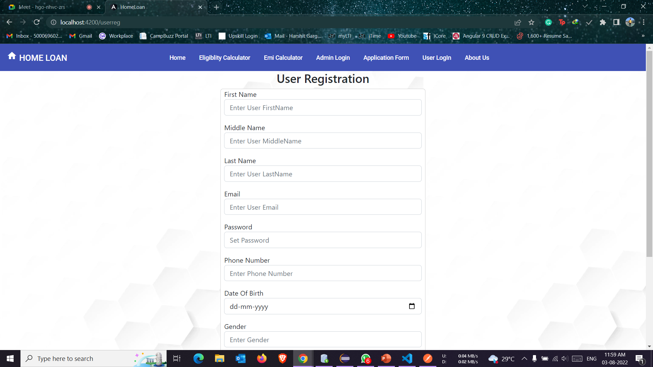

Slide 13
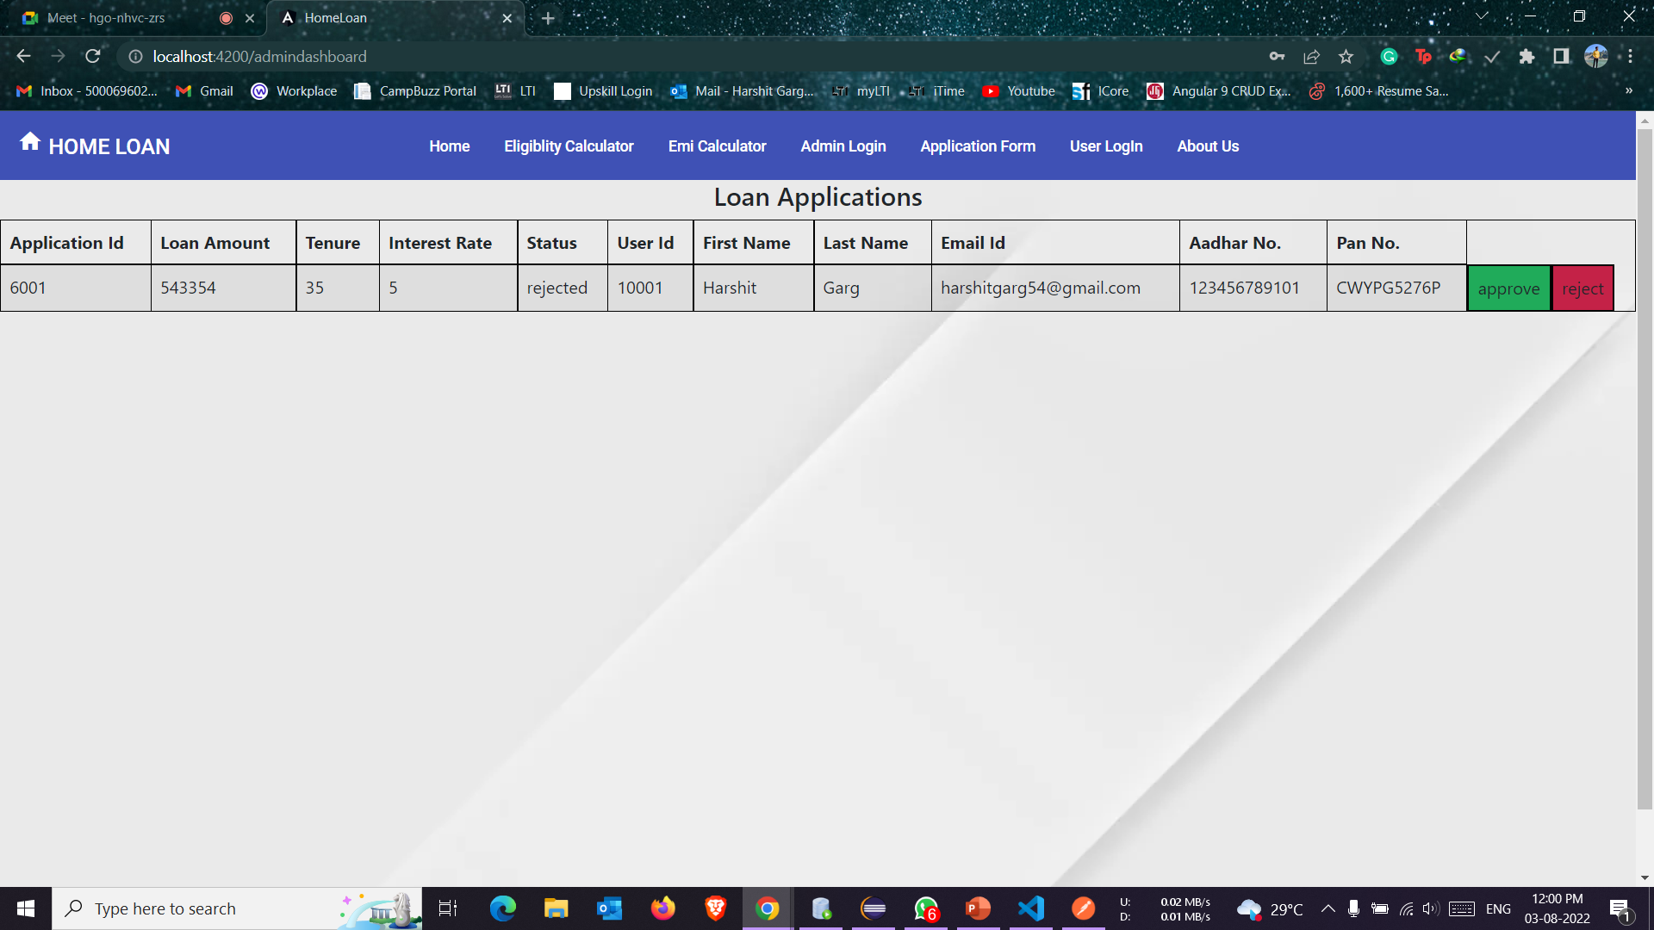

Slide 14
